Slide 1
Bird Sound Identification
Using Deep Learning
Group 5
Ahaz Bhatti
Ha V Phan
Nilisha Makam Prashantha
Shruthi Sathish

Slide 2
Introduction
Background and Motivation

Slide 3
Identify Eastern
African Birds
Indicators of biodiversity changes and influence the success or failure of a restoration project.
Bird biodiversity surveys over large areas is expensive and logistically challenging
Motivation
And
Background
Passive acoustic monitoring (PAM) combined with machine learning captures greater spatial scales and temporal resolution to sample from
Goal is to create computational solutions to process continuous audio data and recognize the species by their calls
https://www.kaggle.com/competitions/birdclef-2023

Slide 4
Literature Review
Digging up the past

Slide 5
Literature Review
Who | What | Data & Models Used | Learnings
Shrestha et al. (2021) - ICANN | Bird Audio Diarization with Faster R-CNN on 50 bird species to effectively tackle the ‘which bird spoke when?’ problem | Bird songs from Europe (Xeno-canto, 2020). Faster-RCNN | Why SVM is not suitable for multi-bird classification. Advantages of NN over SVM
Qu, Y., Li, X., Qin, Z., & Lu, Q. (2022)- Scientific Reports, 12(1). | Acoustic scene classification based on three-dimensional multi-channel feature-correlated deep learning networks. | Audio of environmental sounds of 10 classes (DCASE, 2019). Multiple input 3D CNN model, 3D-SE-ResNet novel model. | Attention mechanisms & data augmentations to increase diversity of train data. Multi-domain spectrograms, deep & shallow-level feature fusion
Howard et al. (2017) | MobileNets: Efficient Convolutional Neural Networks for Mobile Vision Applications | Imagenet, COCO, Mobilenet | Introduce a light weight DNN using depthwise convolutions reduce number of parameters and computational cost
Rahman, Z. (2018, May 1). | Hands-On Transfer Learning with Keras. Learn Data Science. | Pre-trained CNN model (VGG16) as a feature extractor, InceptionV3 for transfer learning. | Transfer learning is a powerful technique that can be used to build high-performance models with relatively little data.
Park and Lee (2022) | SwinE-Net: hybrid deep learning approach to novel polyp segmentation using convolutional neural network and Swin Transformer | Swin and EfficientNet Hybrid | Better performance in the unseen dataset, generalizability, scalability
Notes:
2 paper -
The audio dataset is of environmental sounds like airport , bus, pedestrians etc. It was obtained by DASCE competition of 2019.
They have used 2 models, one is a multi-input multi-branch 3D CNN model that accepts the STFT spectrogram and the Mel spectrogram as the input to derive deep convolution features
Another is a proposed model oF 3D CNN architecture featuring residual connections and squeeze-and-excitation attentions (3D-SE-ResNet)
LEARNINGS - The research used Attention mechanisms & data augmentations to increase diversity of train data. And also had Novelties like constructing multi-domain spectrograms, conducting deep & shallow-level feature fusion to improve the capability of the proposed model.

Slide 6
Data Preparation
Preparatory Nesting

Slide 7
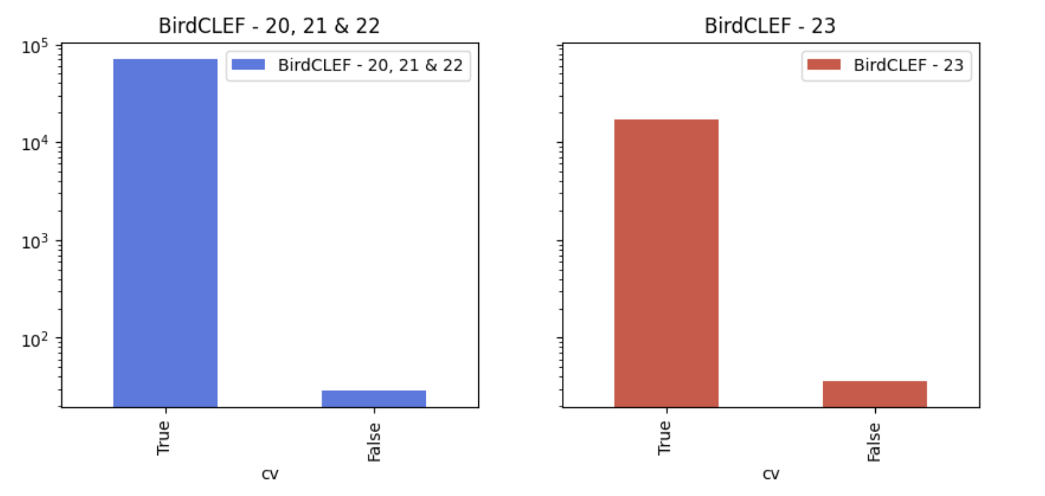
Data Issues and Solutions
Data Used | BirdCLEF 2021/2022 (Pretraining), BIRDCLEF 2023 (Fine-tuning and testing)
Issue | Not enough samples for each bird. There might be only one sample for some classes, we need to make sure they are in the train data
Solution | Filtering - always keeping them in the train data and do CV on the rest of the data.
Method | Define threshold for sample (thr=5) Create new column CV For classes containing less than 5 samples, set CV = False
https://www.kaggle.com/code/awsaf49/birdclef23-pretraining-is-all-you-need-train

Slide 8
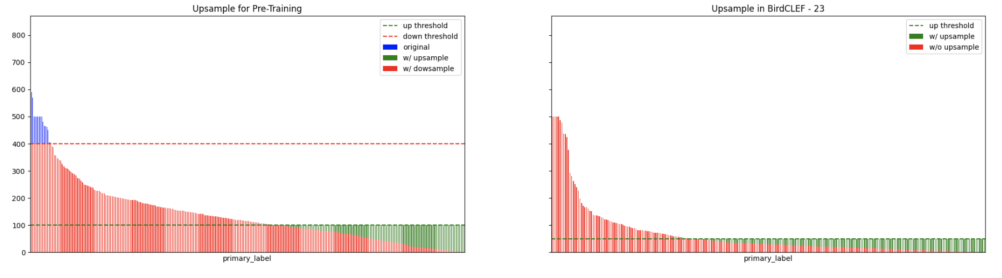
Data Issues and Solutions
Issue | Biased Data - Even in the filtered data there are some minority classes with very few samples. This leads to the “Long Tail” problem
Solution | Upsample, and down sample
Method | Upsample the train data for minory class which has very few samples Downsample to ensure maximum sample of a class
https://www.kaggle.com/code/awsaf49/birdclef23-pretraining-is-all-you-need-train

Slide 9
Data Pipeline
Pre-processing
Audio Decoding | Convert raw audio from .ogg file and also decode spectrogram from audio file
Audio Augmentation | Gaussian Noise, Random CropPad, CutMix and MixUp
Normalize | Standardize the data using mean and std then rescales the data to [0, 1]
Spectrogram Augmentation | TimeFreqMask
https://www.kaggle.com/code/awsaf49/birdclef23-pretraining-is-all-you-need-train

Slide 10
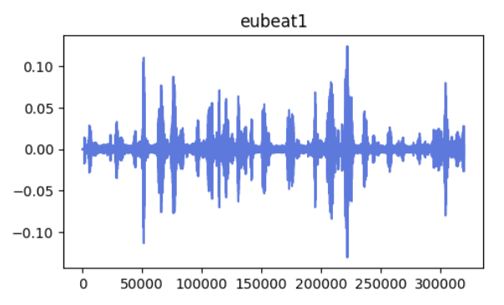
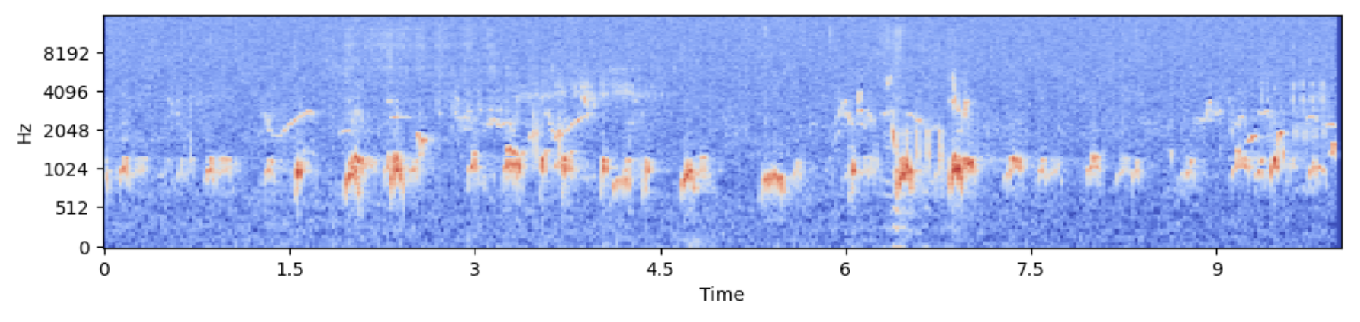
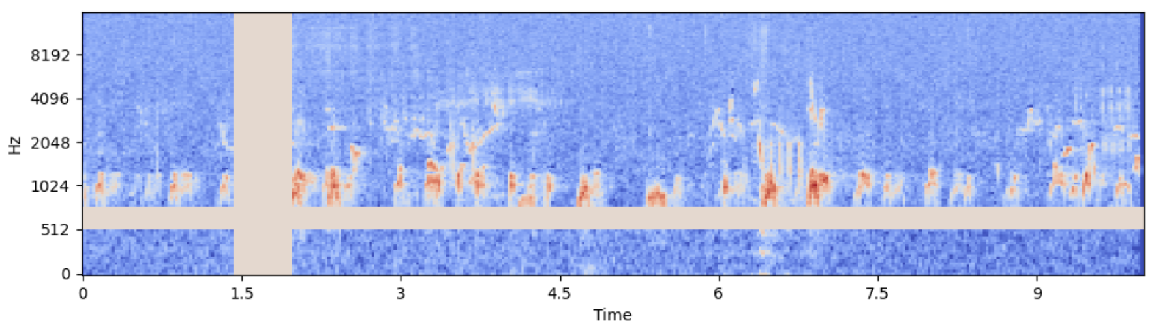
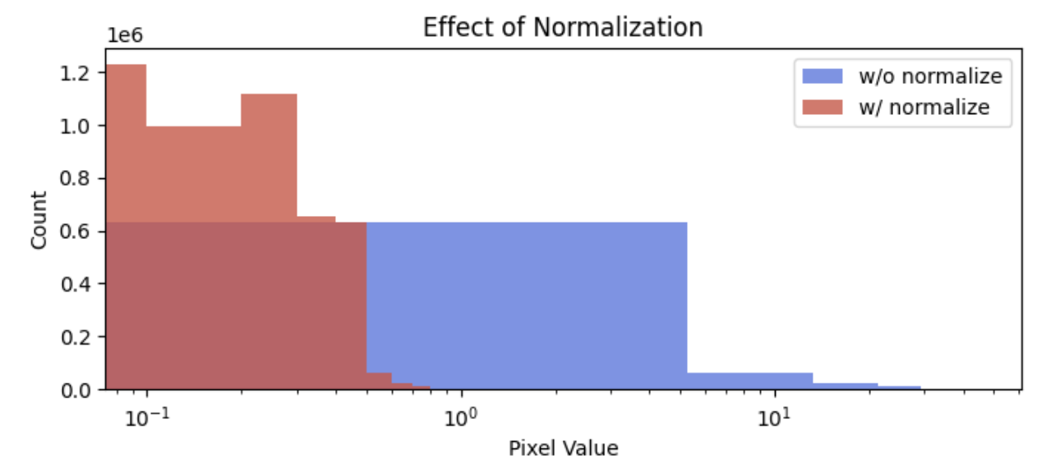
Data Pre-processing
Augmented Audio Signal
Mel Spectrogram
Time Frequency Mask
Normalized Data
https://www.kaggle.com/code/awsaf49/birdclef23-pretraining-is-all-you-need-train

Slide 11
Data Preparation
Evaluation Metrics
StratifiedKFold | split the data into folds using target stratification Note: Some classes have too few samples thus not each fold contains all the classes
Shuffle | To avoid overfitting and improve performance
Pre-training (BirdCLEF 2021 and 2022) | Image Size: (128, 384) batch size: 256 Train: 70,760 Valid: 2,838
Fine-Tuning & Testing (BirdCLEF 2023) | Train: 19,627 Valid: 1,700 Test: 1,700
Loss | Categorical Cross Entropy (CCE)
performance metrics | AUC and Accuracy
Efficiency Metrics | Accuracy = ((y_{pred} - y_{missclass})/y_{pred})*100
https://www.kaggle.com/code/awsaf49/birdclef23-pretraining-is-all-you-need-train

Slide 12
Modeling
Building Nests

Slide 13
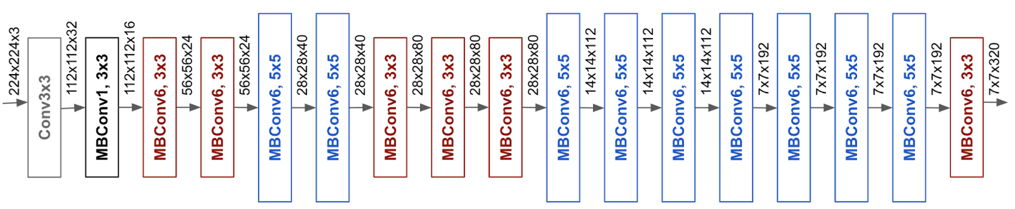
EfficientNet-CNN
Batch_size, height, width(variable), Channels(1280)
Audio Files converted into Mel Spectrogram images - Input Shape
EfficientNet B1 Model
1 layer
Conv2D (32)(3X3), RELU
Maxpooling 2D (2X2)
2 layer
Conv2D (64)(3X3), RELU
Maxpooling 2D (2X2)
Number of parameters in EffNetB1 | 6,575,232
Number of parameters in CNN | 964,328
Total Number of parameters in Network | 7,539,560
Total Trainable parameters | 7,477,512
Non-Trainable parameters | 62,048
3 layer
Conv2D (128)(3X3), RELU
Maxpooling 2D (2x2)
Dropout (0.5)
Global Average Pooling 2D
Dense (1280), RELU
Dense (264) SOFTMAX
https://ai.googleblog.com/2019/05/efficientnet-improving-accuracy-and.html
Notes:
In our Project, we have tried to experiment with 4 kinds of models.
One of the model is appending a custom cnn network to an efficientNet Pretrained model using Transfer learning.
I removed the classification layer of the pretrained model and added the feature map directly
The reason for choosing efficientnet is because it uses some innovating concepts like compound scaling, this uniformly scales the depth, width and the resolution of the network. It is also trained on imagenet dataset and supposed to work very well for image classification task and provides better parameter efficiency.
For the custom cnn network, i tried multiple variations inspired by one of the literature surveys, and also tried building. without pretrained model. BUt the one i got the best results was this architecture where i used 3 simple cnn layers with 3X3 kernels, relu activation along with maxpooling with 2x2 kernels.
For the custom cnn network in, I have used 3x3 kernel size, 2D convolution and Relu activation function. Followed by maxpool with 2X2 filter
And after each layer i increased the filter size. Before i finalized on this network i tried multiple variations. One of them was inspired by one of the literature surveys where i tried adding 3D CNN layers with the same architecture as the research paper, another variation was using a deep cnn model without performing transfer learning and the final variation was teh one you are seeing now, i.e. a simple cnn network along with effnet model.
I chose this because interestingly, all other variations gave very less accuracy compared to this one. Mostly because this is a light model with lesser number of parameters , which is why it helped me train it faster than others.
The reason of choosing this particular kernel size, dimensions and activation function was a collective decision made by doing the previous assignments we did and the lectures i attend followed by different architectures researched on the internet,
I added dropout 0.5 as it understood that it was the most used and the best value we can add for dropout.
The reason I chose maxpooling instead of stride is because stride reduces loss of informationand lower accuracy in certain cases.

Slide 14
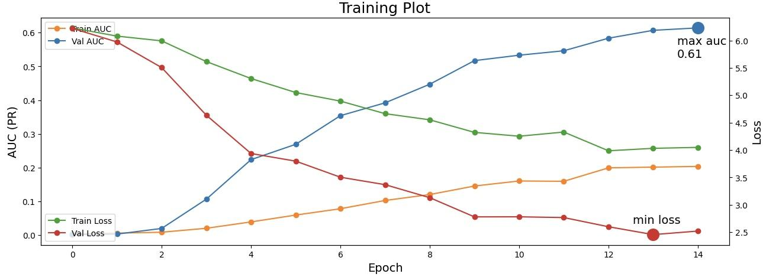
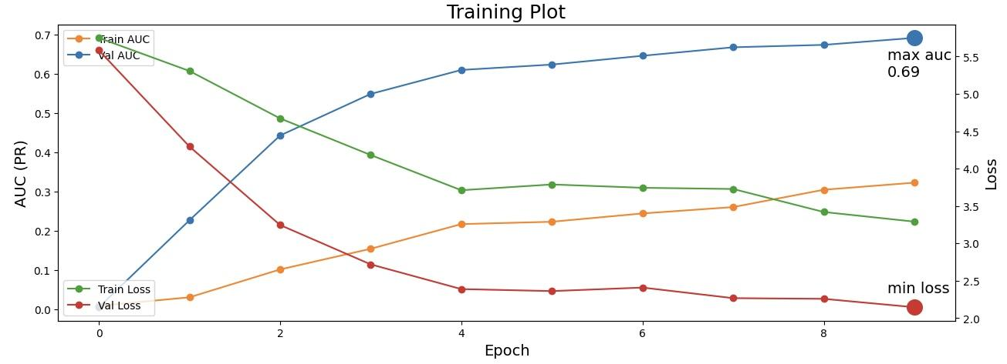
EfficientNet-CNN Results
Pretrained on BirdCLEF 2021/2022
Pretrained on BirdCLEF 2021 & 2022
 | AUC | Loss | Accuracy
Pretrained (validation) | 0.61 | 2.5 | N/A
Fine-Tuned (validation) | 0.69 | 2.1 | 0.65
Testing | N/A | N/A | 0.86
Fine-tuned on BirdCLEF 2023
Notes:
We pretrained the model initially for 2021 and 2022 datasets , for which i got an auc of 0.70 and for training we got an auc of 0.74.
And the validation loss i got for pretraining is 2.13 and for finetuning it is 1.95
For my pretrained model, you can see that the training auc is < than 0.5 , which says that model is not that great.

Slide 15
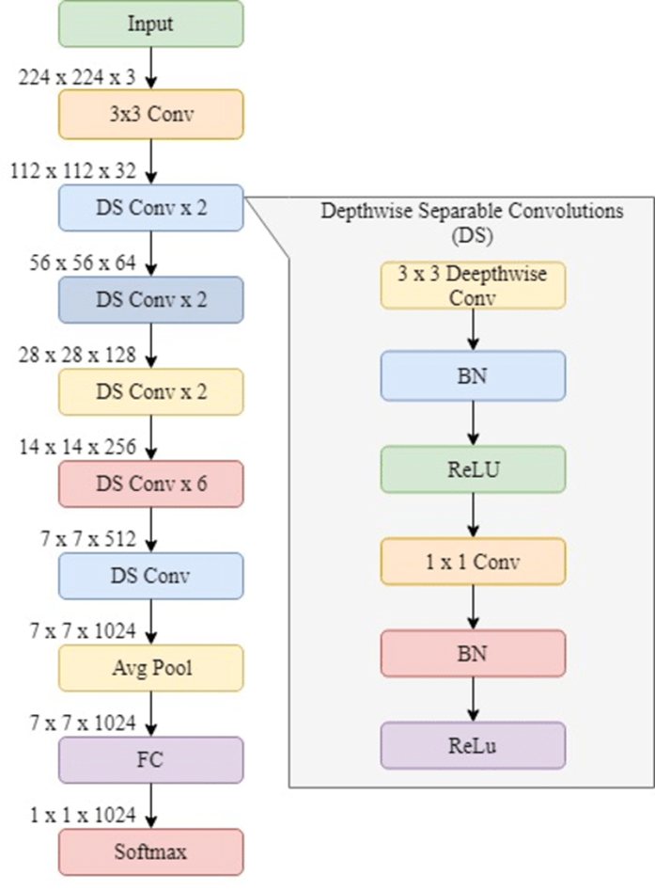
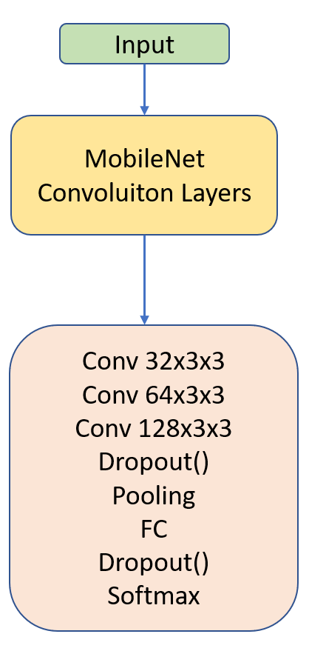
MobileNet-CNN
Number of parameters in MobileNet | 2,257,984
Number of parameters in CNN | 964,328
Total Number of parameters in Network | 322,312
Total Trainable parameters | 3,188,200
Non-Trainable parameters | 34,112

Slide 16
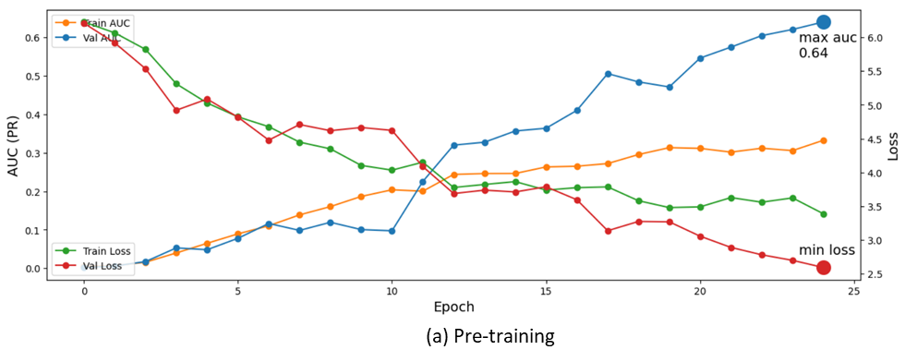
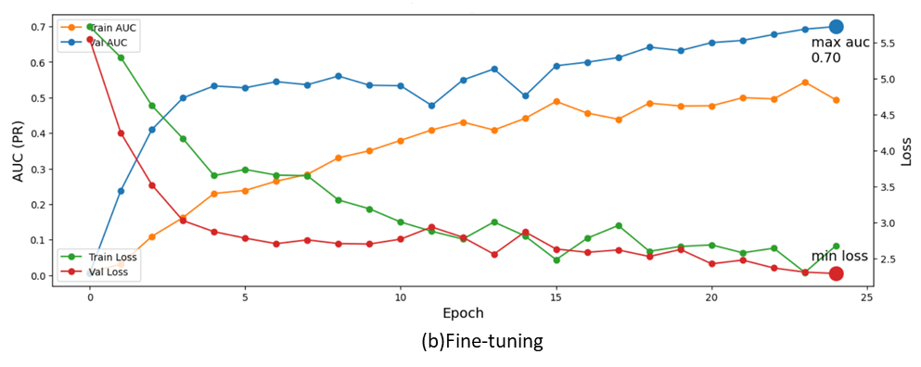
MobileNet-CNN Results
 | AUC | Loss | Accuracy
Pretrained (validation) | 0.64 | 2.5 | N/A
Fine-Tuned (validation) | 0.70 | 1.5 | 0.66
Testing | N/A | N/A | 84.37

Slide 17
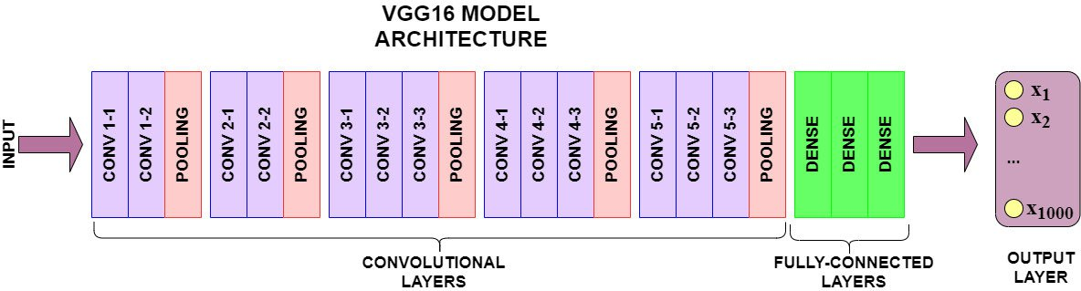
VGG16 - RCNN
Audio Files converted into Mel Spectrogram images - Input Shape
RCNN
VGG16
1 Dense layer
(1024), RELU
1 layer
Conv2D (128)(1X3), RELU
2 Dense layer
(1024), RELU
2 layer
Conv2D (128)(3X3), RELU
Dense (264) SOFTMAX
3 layer
Conv2D (256)(3X3), RELU
Number of parameters in VGG16 | 14,714,688
Number of parameters in CNN | 29,516,8
Total Number of parameters in Network | 16,806,472
Total Trainable parameters | 16,806,472
Non-Trainable parameters | 0
Global Average Pooling 2D
Dense (264) SOFTMAX

Slide 18
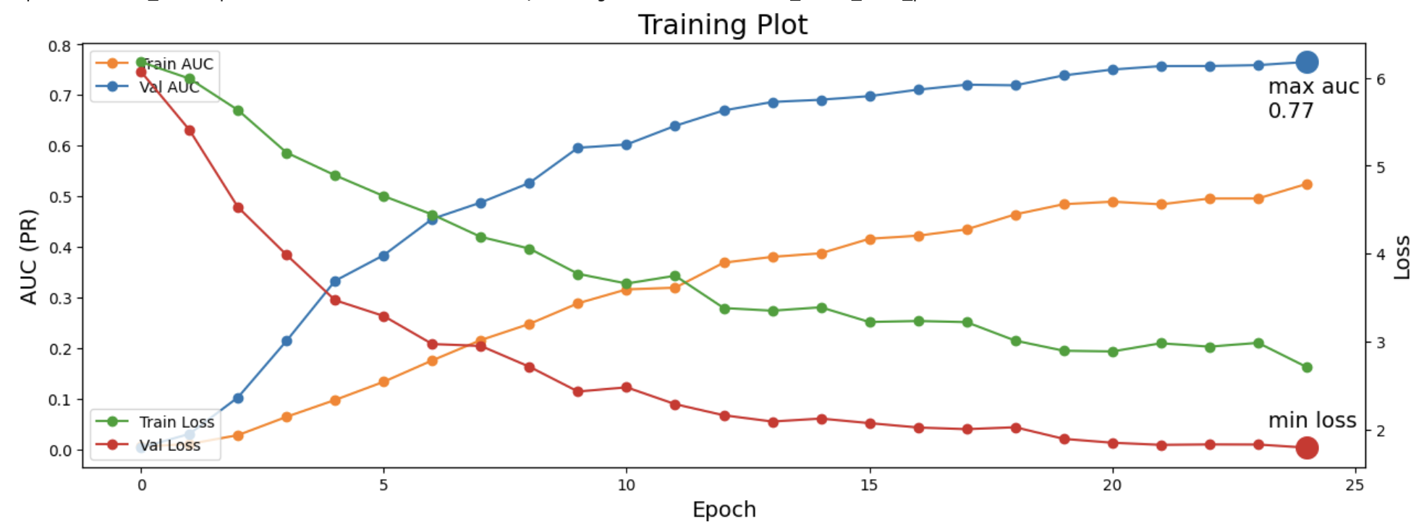
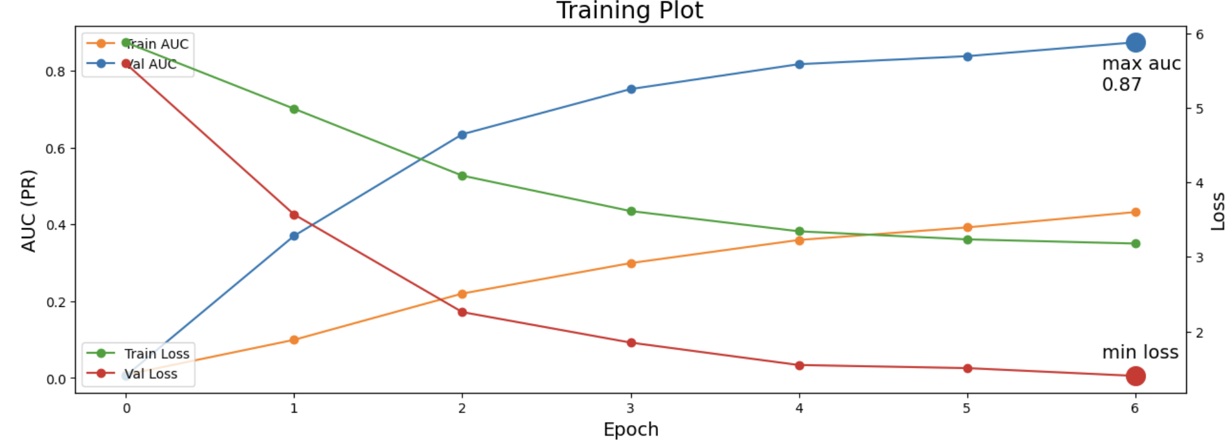
VGG16 - RCNN Results
VGG16 - RCNN | AUC | Loss | Accuracy
Pretrained (validation) | 0.77 | 1.9 | N/A
Fine-Tuned (validation) | 0.873 | 1.4(approx) | 81.130
Testing | N/A | N/A | 78.90625
VGG16 R-CNN Pre-training on 2021 and 2022 dataset
VGG16 R-CNN Fine-tuning on 2023 dataset

Slide 19
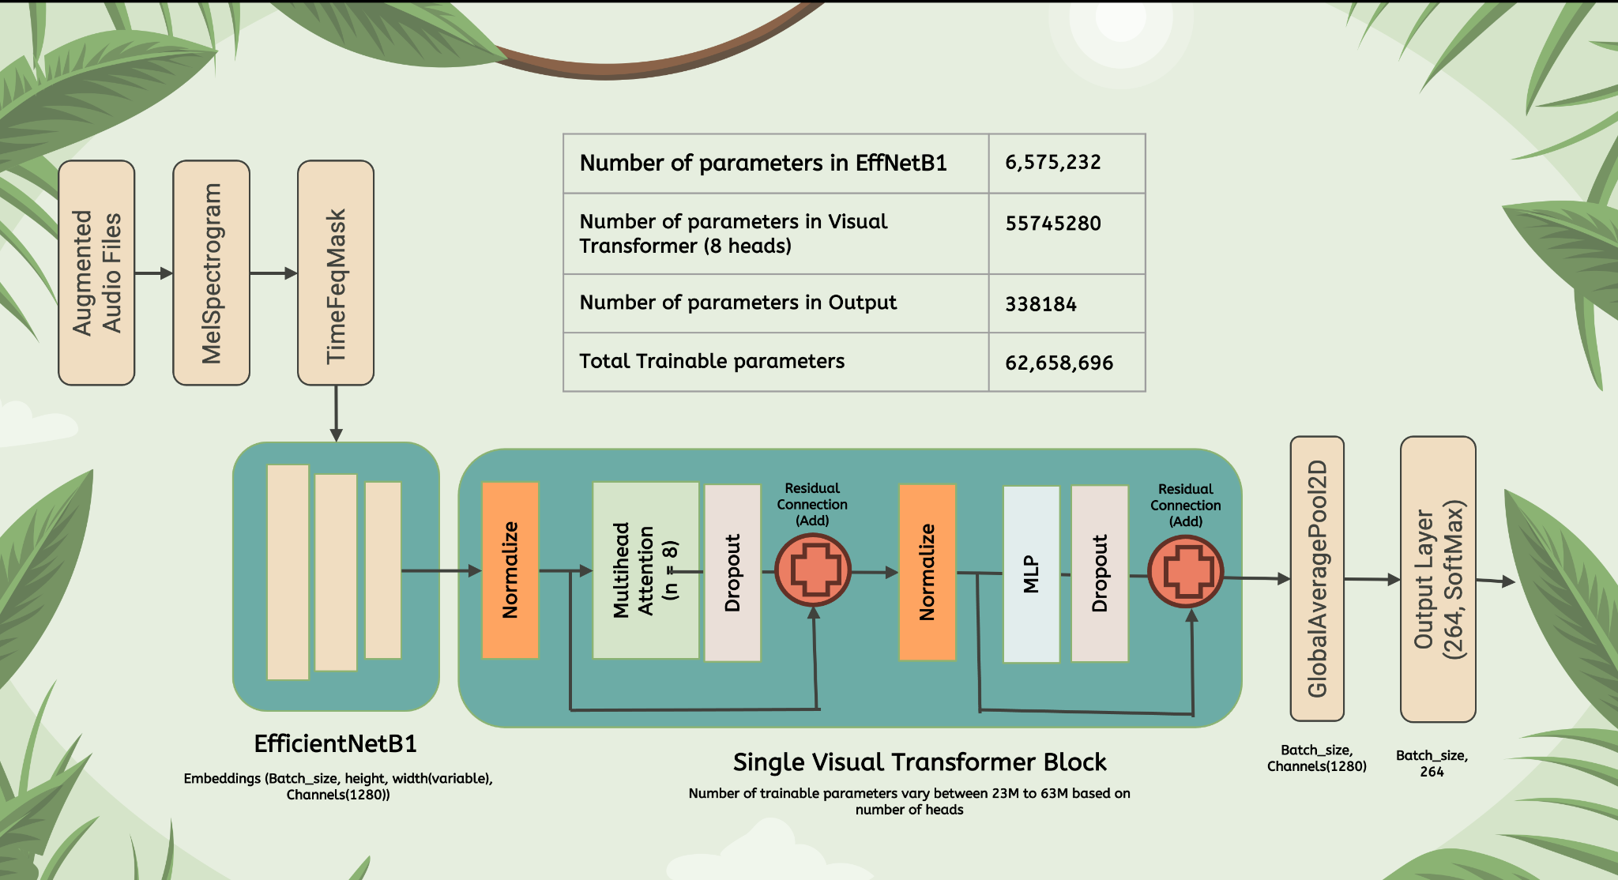
ENet- Vision Transformer

Slide 20
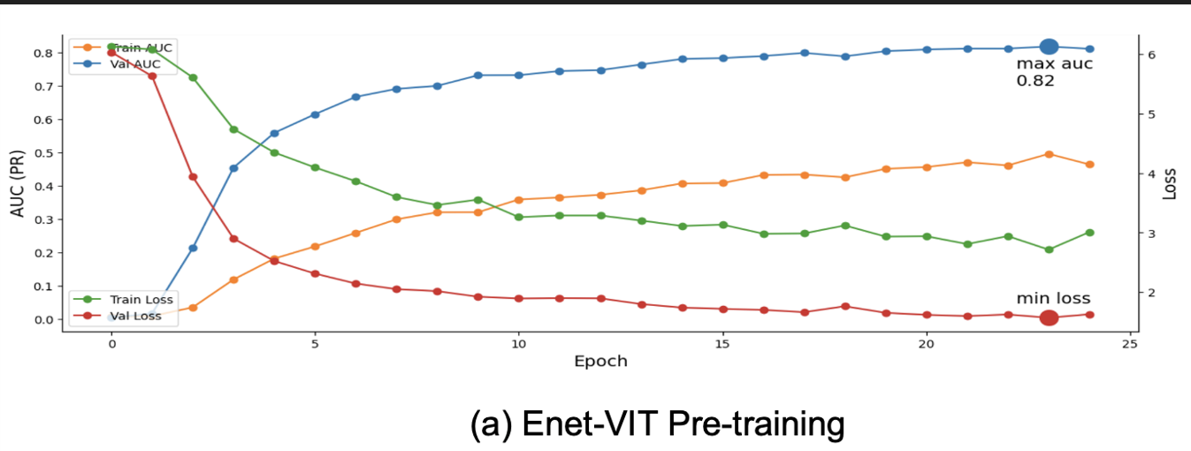
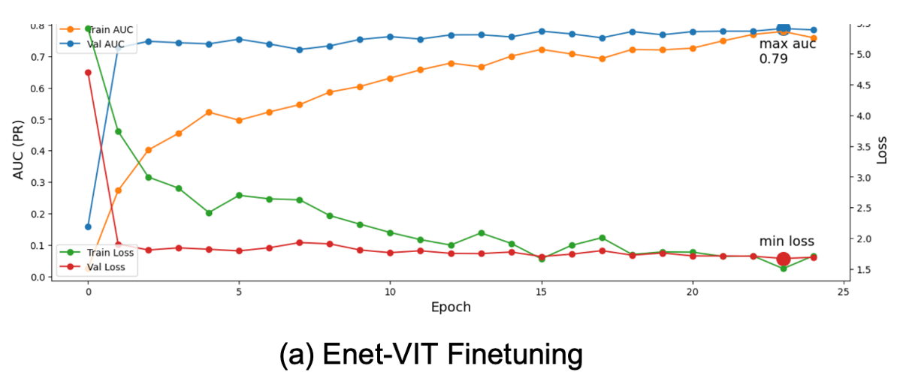
ENet- Vision Transformer Results
Pretrained on BirdCLEF 2021 & 2022
8 Heads | AUC | Loss | Accuracy
Pretrained (validation) | 0.82 | 0.12approx) | N/A
Fine-Tuned (validation) | 0.79 | 0.18(approx) | 0.889
Testing | NA | NA | 0.87
Fine-tuned/Tested on BirdCLEF 2023

Slide 21
Discussions
Counting the Eggs

Slide 22
Comparison and Final Results
 | Fine-tuning Validation Accuracy | Testing Accuracy
ENet-CNN | 0.65 | 0.86
MobileNet-CNN | 0.66 | 0.85
VGG16-RCNN | 0.81 | 0.78
ENet- Vision Transformer | 0.74 | 0.97

Slide 23
Limitations and Future work
Diverse Data
Real Data
Time and Space
Clustering
Manual
Data Collection
Optimize
Class Imbalance
Unsupervise

Slide 24
Project contribution
Ahaz
Ha
VGG16 - RCNN
MobileNet - CNN
Nilisha
Shruthi
ENet - CNN
ENet - Vision Transformer

Slide 25
Thank You!
Q and A

